Slide 1



ADVENTURE
WORKS CYCLES

Slide 2
Contents
INTRODUCTIONS
1 TEAM
2 COMPANY OVERVIEW
3 GOALS
ANALYSIS AND REPORTS
4 KPI’S
5 EXCEL
6 TABLEAU
7 POWER-BI
8 MYSQL
HIGHLIGHTS
9 KEY LEARNING
10 PROJECT SUMMARY

Slide 3
TEAM
JAYANTHY PRAHASHIT
ALSHA KUMARI
JAHNAVI ADAPA
PRERANA ALANDE
SOMYA BEHERA
SUMIT NAYAK
ROHIT CHAVAN

Slide 4
Company Overview
Introduction
#1
#2
Multinational cycle manufacturing company.
Manufactures and sells metal and composite bicycles to North American, European and Asian commercial markets
#3
#4
#5
The main plant is in Bothell, Washington with 290 employees, several regional sales teams are located throughout their market base.
In 2000s, Adventure Works Cycles bought a small manufacturing plant in Mexico. Which manufactures several critical subcomponents for the product line.
Adventure Works plans to target top customers, expand online, and reduce production costs.

Slide 5

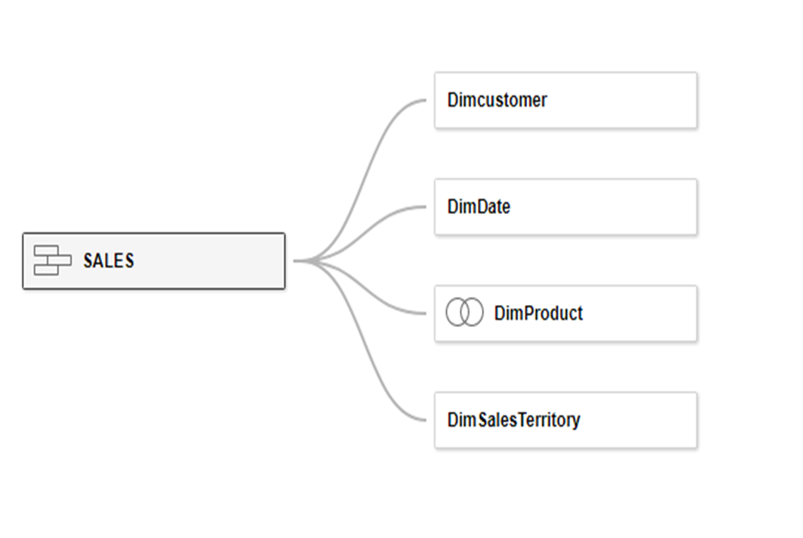

Goals
Leverage data-driven insights to optimize sales, customer behavior, and profitability.
Analyze sales patterns to identify growth opportunities.
Understand customer preferences for better decision-making.
Deliver actionable insights to guide strategic business decisions.

Slide 6

KPI’S AND INSIGHTS

Slide 7




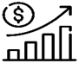
Sales
Profit
Customers
Cost
Income
Quantity
Average Order Value
Average Orders per Day
Average Shipping Time
Average Shipping Cost
Profit Margin

Slide 8
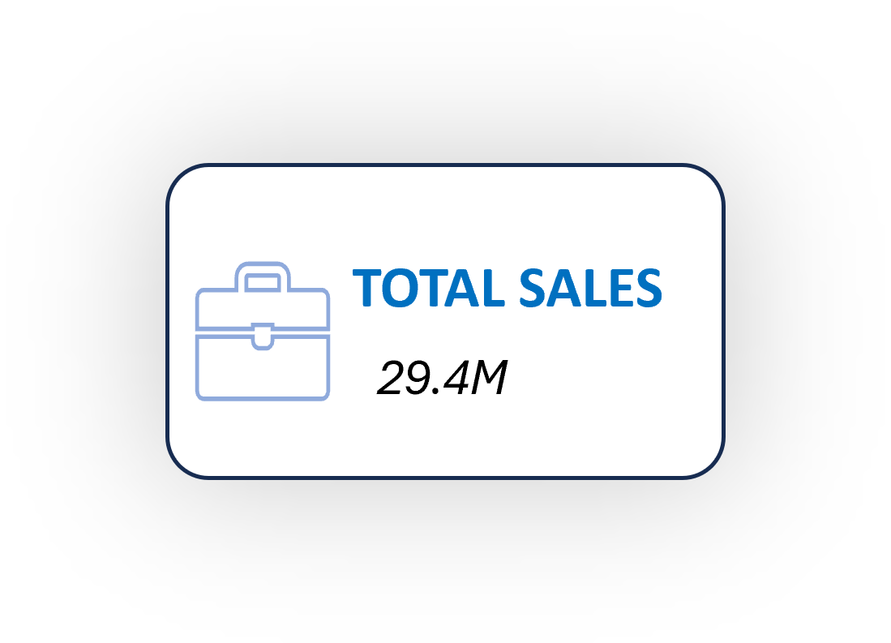
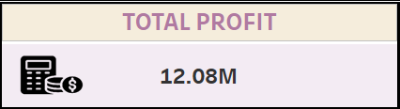
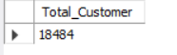
Sales: The total sales analysis reveals trends, peak periods, and top-performing markets, aiding in revenue optimization and strategic targeting.
Profit: The profit analysis highlights key drivers, including top regions and products, aiding in cost optimization and growth strategies.
Customers: The customer analysis highlights demographics and behaviors to guide targeted marketing strategies.

Slide 9
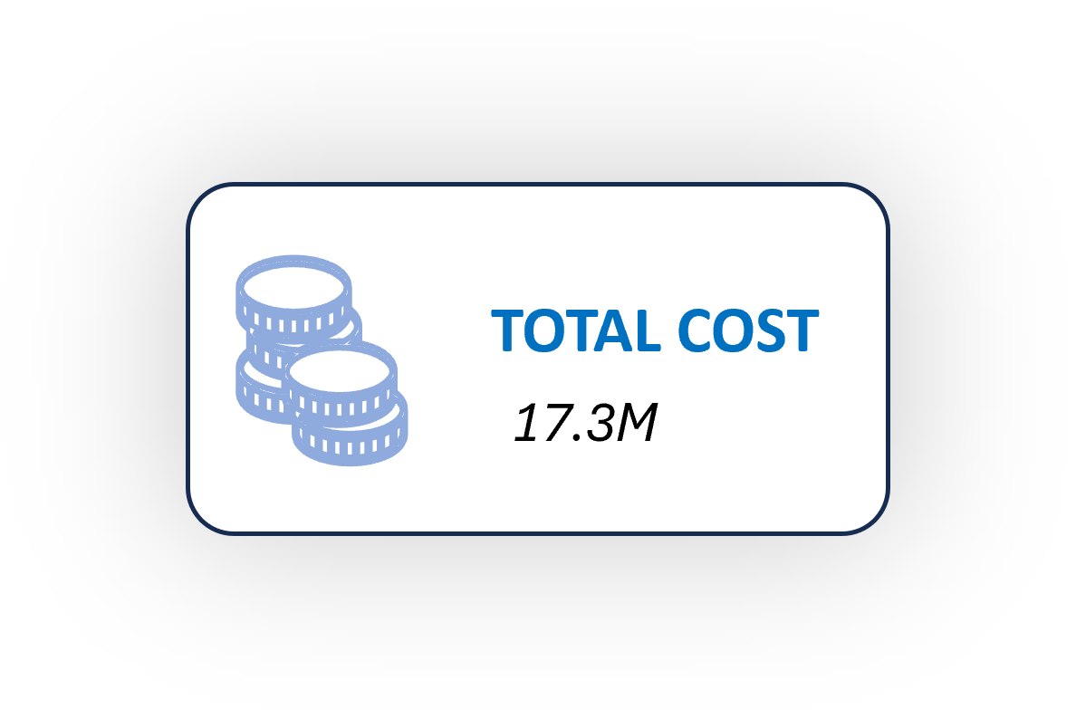
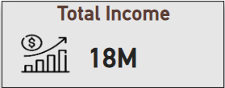
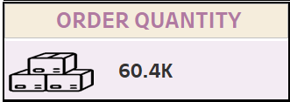
Cost: The total cost analysis outlines production and operational expenses, supporting strategies for cost reduction and efficiency improvements.
Income: The combined earnings of all individuals in a group, reflecting their overall purchasing power.
Order Quantity: The total number of items requested or purchased in a specific order. It helps businesses track demand, manage inventory, and optimize supply chain processes.

Slide 10
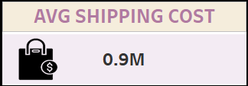
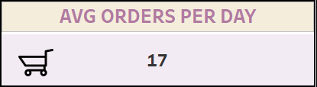
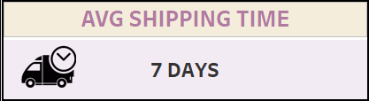
Average Shipping Cost: This method estimates shipping costs by taking the difference between sales and profit, then applying a 5% rate to that value.
Formula: ([Sales Amount]-[Profit])*0.05
Average Order per Day: The Average Order per Day is calculated by dividing the total order quantity by the number of unique days, giving businesses an idea of the average daily orders processed over a period.
Formula: COUNT([Order Quantity])/COUNT([Dates])
Average Shipping Time: Average Shipping Time calculates the time difference between the order date and ship date in days, helping businesses measure how long it takes to ship orders.
Formula: DATEDIFF('day',[Order Date Key],[Ship Date Key])

Slide 11
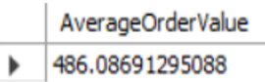
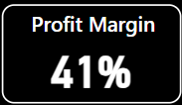
Average Order Value: The Average of all orders analysis reveals trends, peak periods, and top-performing markets, aiding in revenue optimization and strategic targeting.
Formula: AVG(SalesAmount)
Profit Margin: It calculates the ratio of profit to sales, showing how much profit is made for every dollar of sales. It’s found by dividing total profit by total sales amount.
Formula: DIVIDE(SUM(Sales[Profit]), SUM(Sales[Sales Amount]))

Slide 12

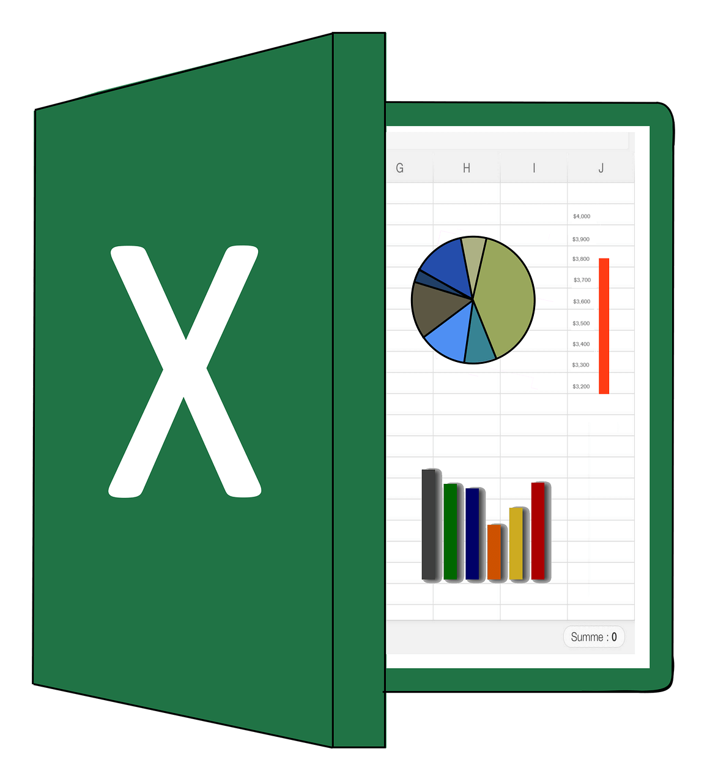

EXCEL DASHBOARDS

Slide 13
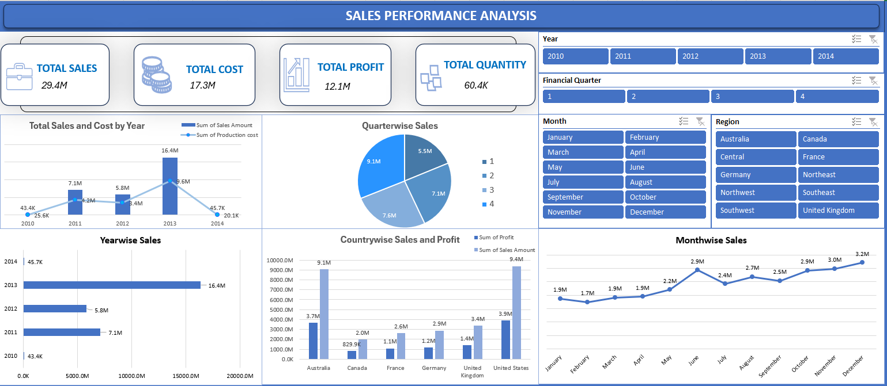
DASHBOARD 1

Slide 14
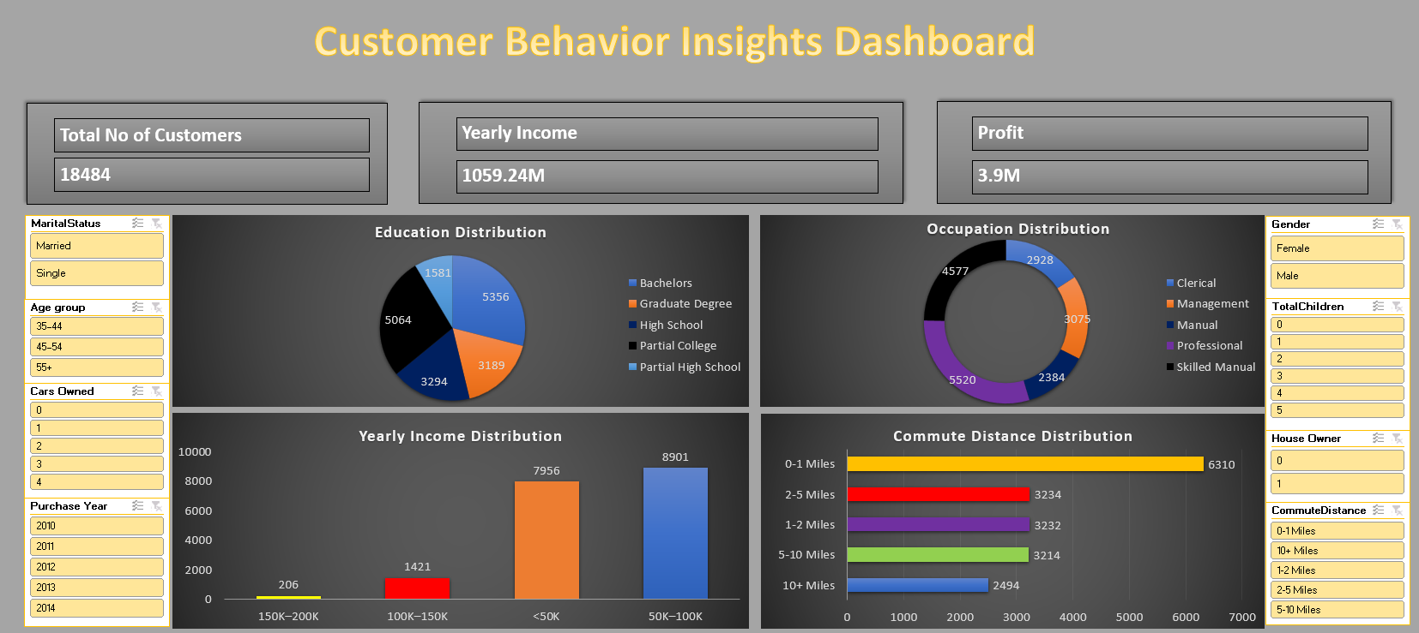
DASHBOARD 2

Slide 15
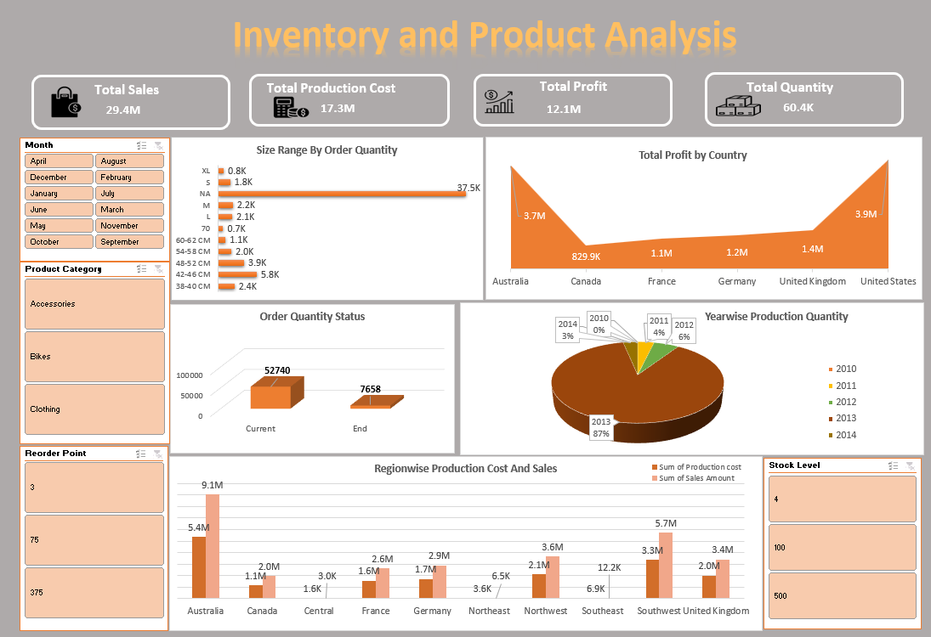
DASHBOARD 3

Slide 16


TABLEAU DASHBOARDS

Slide 17
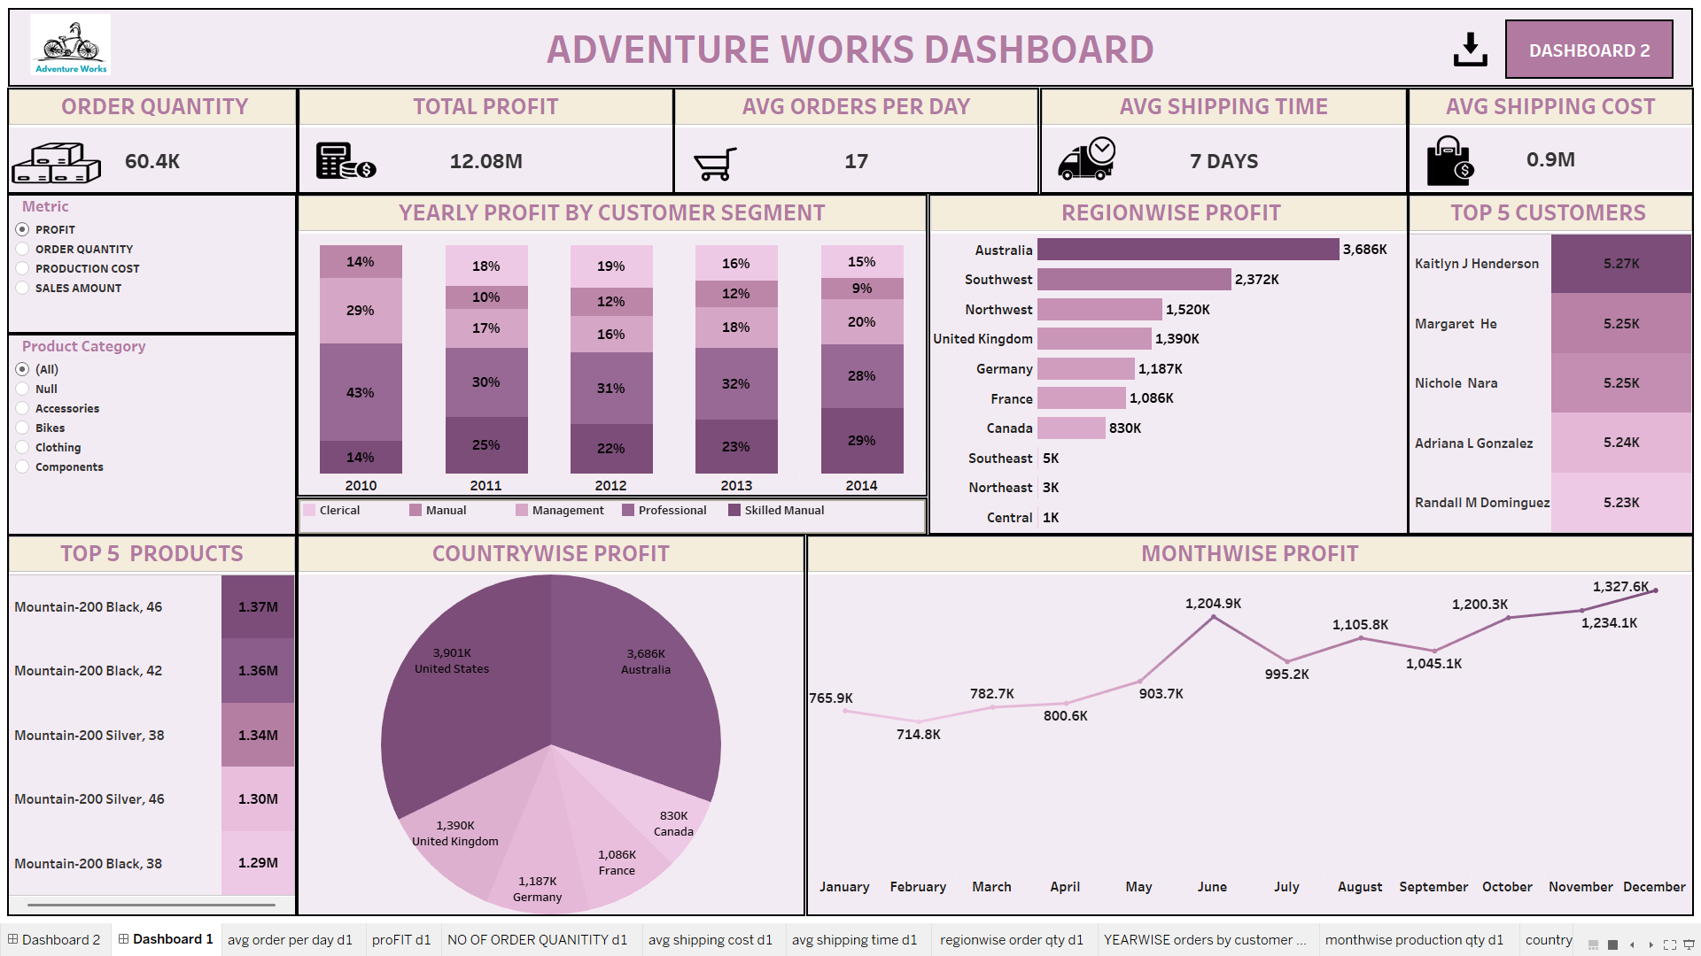
DASHBOARD 1

Slide 18
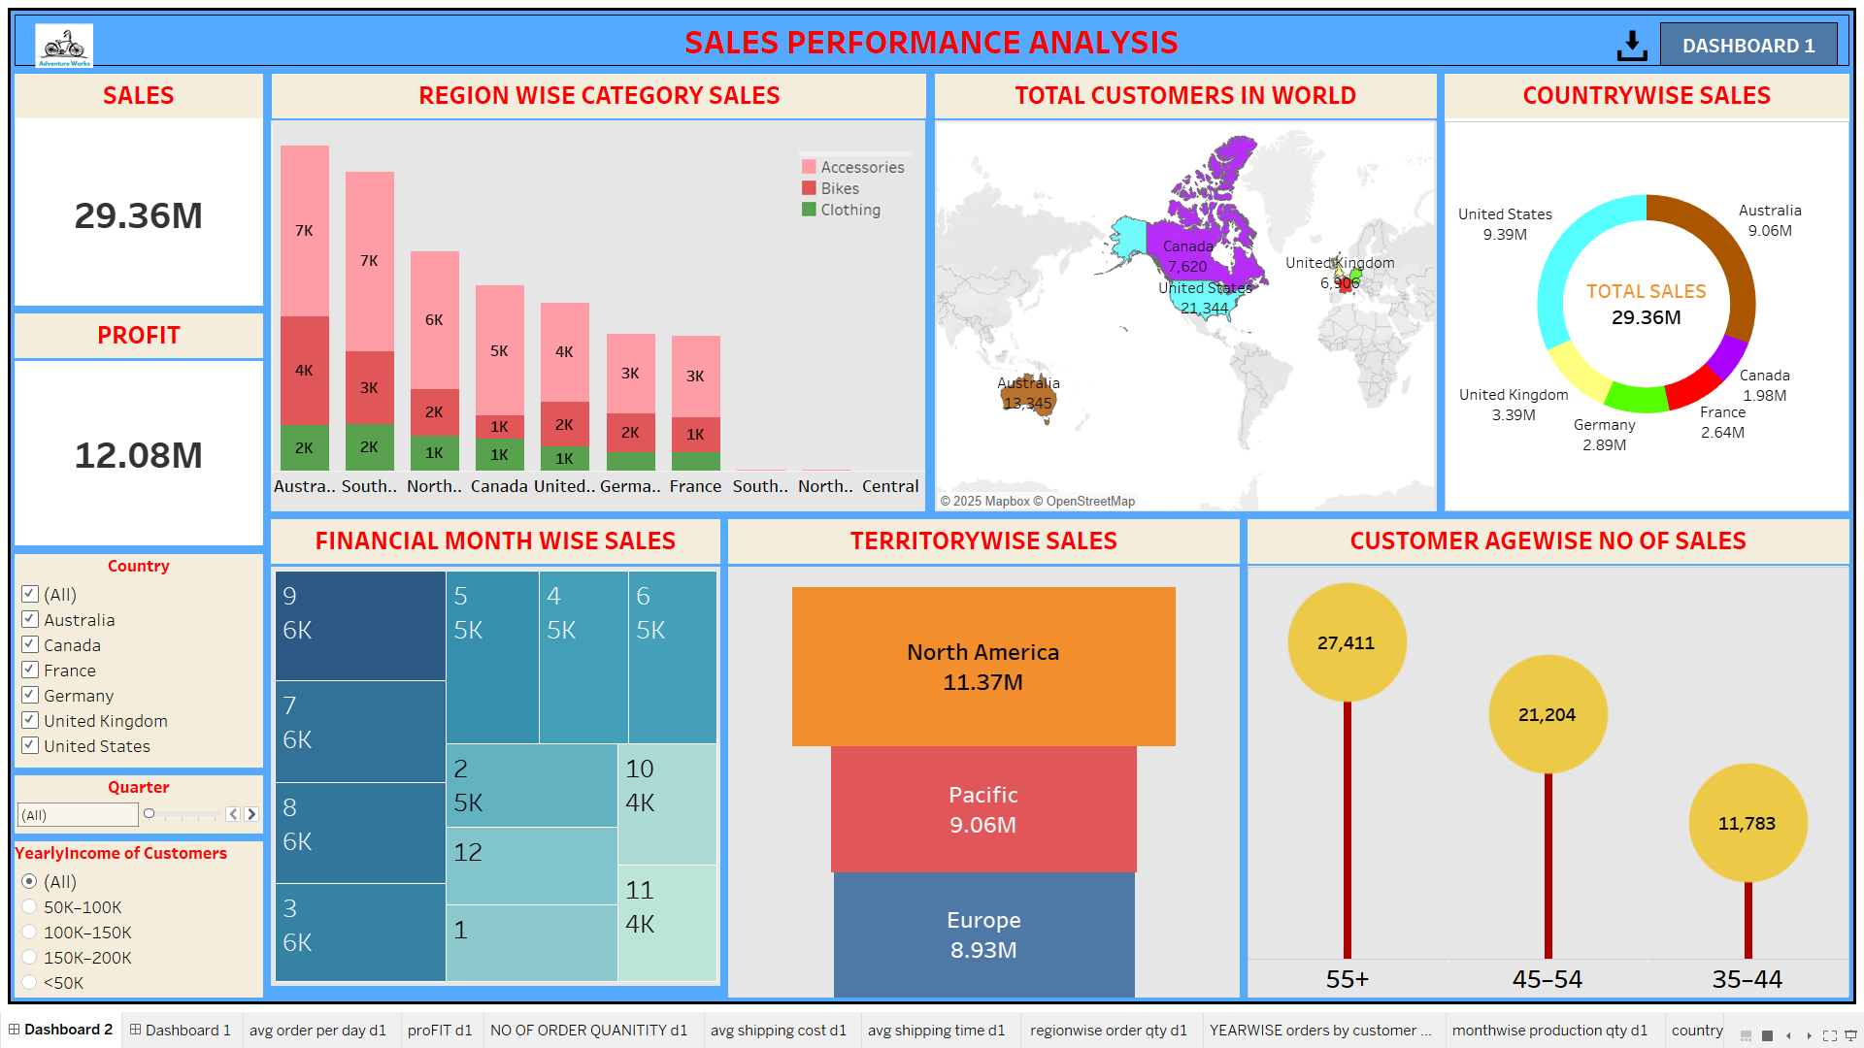
DASHBOARD 2

Slide 19


POWER-BI DASHBOARDS

Slide 20
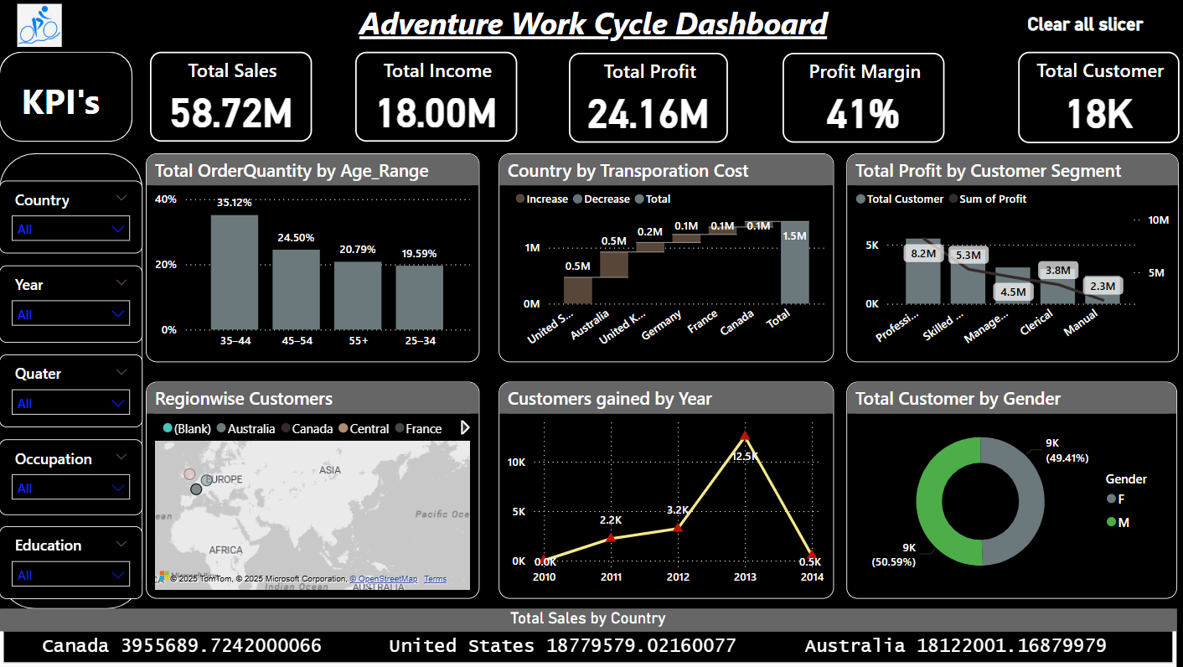
DASHBOARD 1

Slide 21
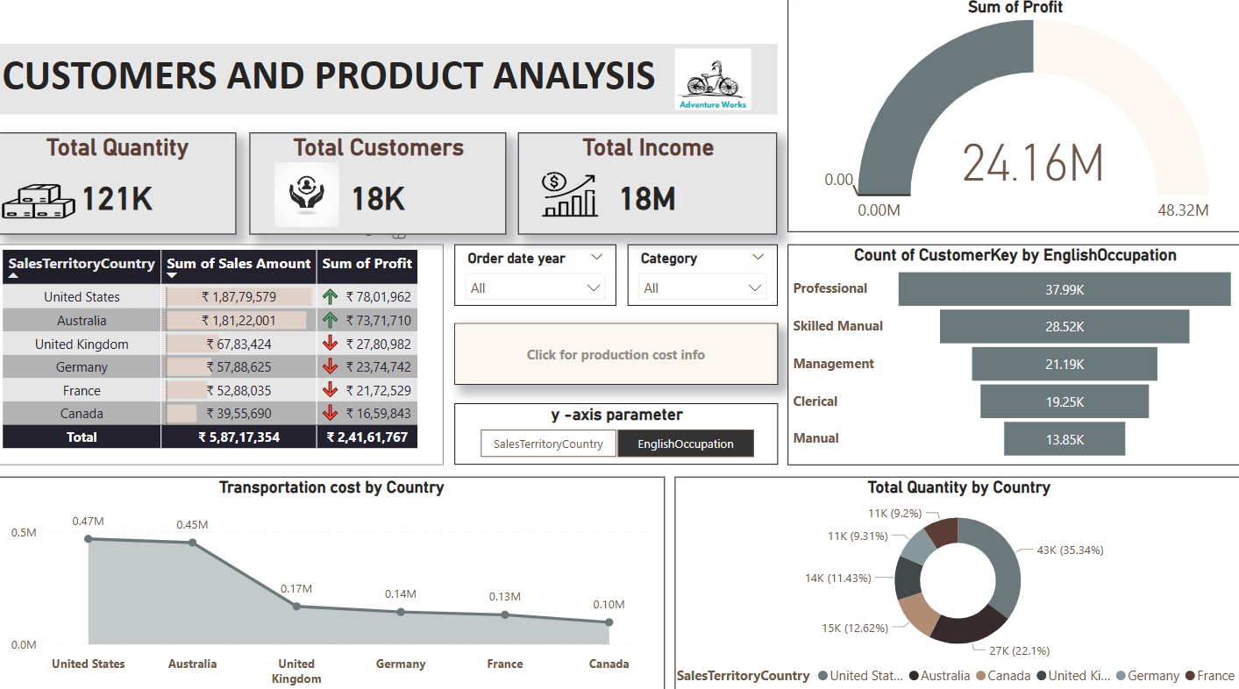
DASHBOARD 2

Slide 22


MYSQL

Slide 23
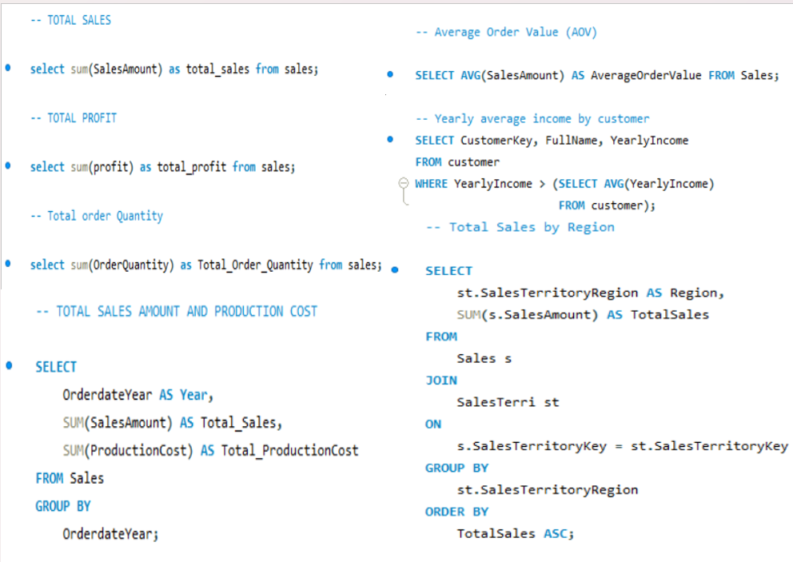

Slide 24
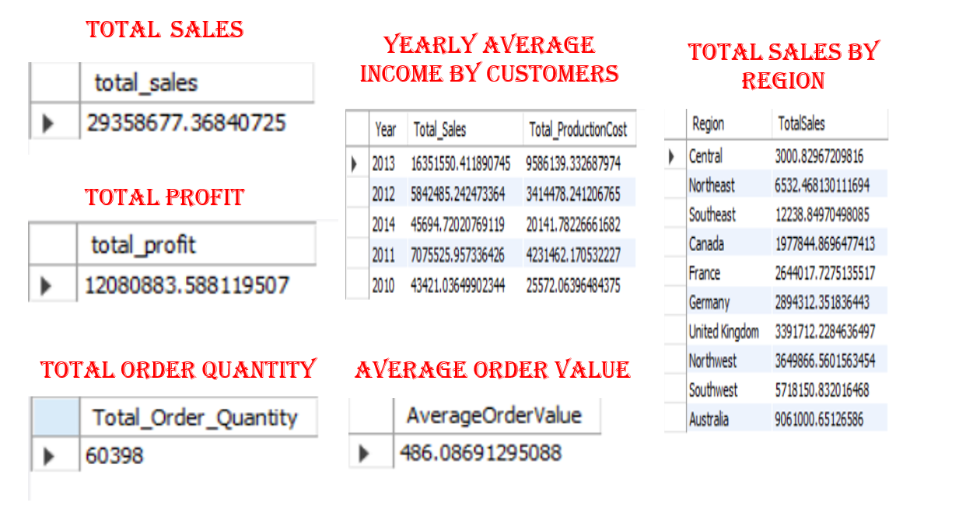

Slide 25
Key Learnings
Identifying peak sales periods, top-performing regions, and seasonal demand patterns.
Understanding customer demographics, occupations, and locations for targeted marketing.
Optimizing inventory management to align stock levels with demand.
Utilizing dashboards to analyze order quantities, profits, shipping metrics, and customer behavior.
Leveraging Power BI to assess sales distribution, customer growth, and transportation costs.
Extracting key business metrics through SQL, including total sales, profit, and order quantities.
Analyzing AOV and identifying high-value customers for better business strategies.
Evaluating regional sales trends to optimize market expansion and logistics.
Using data-driven insights to enhance customer engagement and maximize profitability.
Continuously refining analytics for competitive advantage and long-term business success.

Slide 26
Summary
The sales analysis project identifies peak sales periods, top-performing regions, and seasonal trends. It examines customer demographics, occupations, and locations to enhance targeted marketing. Inventory management insights help optimize stock levels and production efficiency. The Adventureworks dashboard tracks orders, profit, shipping, and customer segments, while the Sales Performance dashboard focuses on sales distribution, demographics, and market trends. Power BI provides insights into sales, customer growth, profit, and transportation costs. SQL queries extract total sales, profit, and order quantities while analyzing AOV and high-value customers. Regional sales trends are identified using SQL joins, revealing strong and weak markets. These insights drive strategic decisions to improve sales, customer engagement, and operational efficiency. The combination of dashboards and SQL analysis ensures a data-driven approach to business growth. Continuous monitoring and refinement of these insights will help maintain competitive advantage and long-term success.

Slide 27

THANK YOU!

